Slide 1
Crop forecasting in Morocco
Book in press
Balaghi R., Jlibene M., Tychon B., Eerens H.

Slide 2
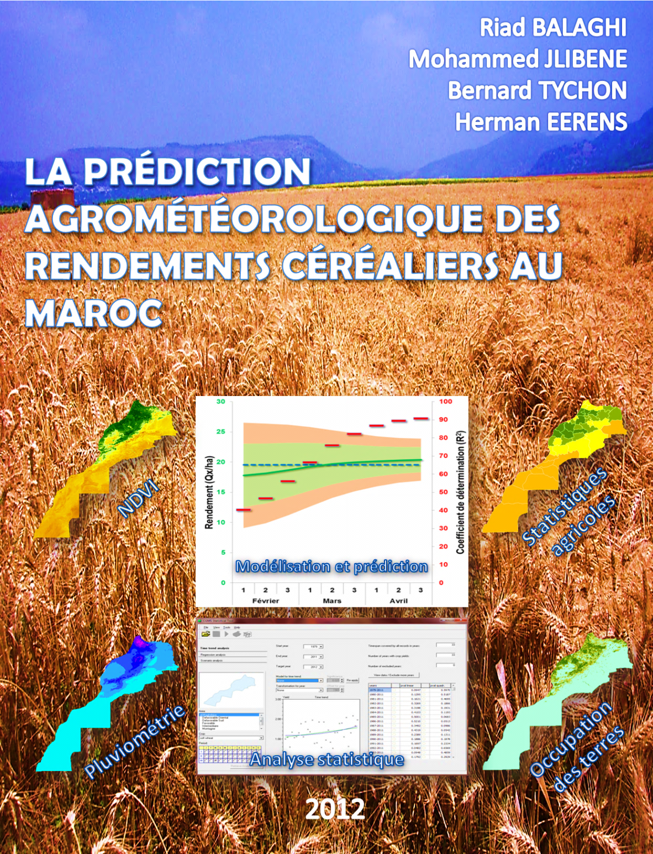

Slide 3
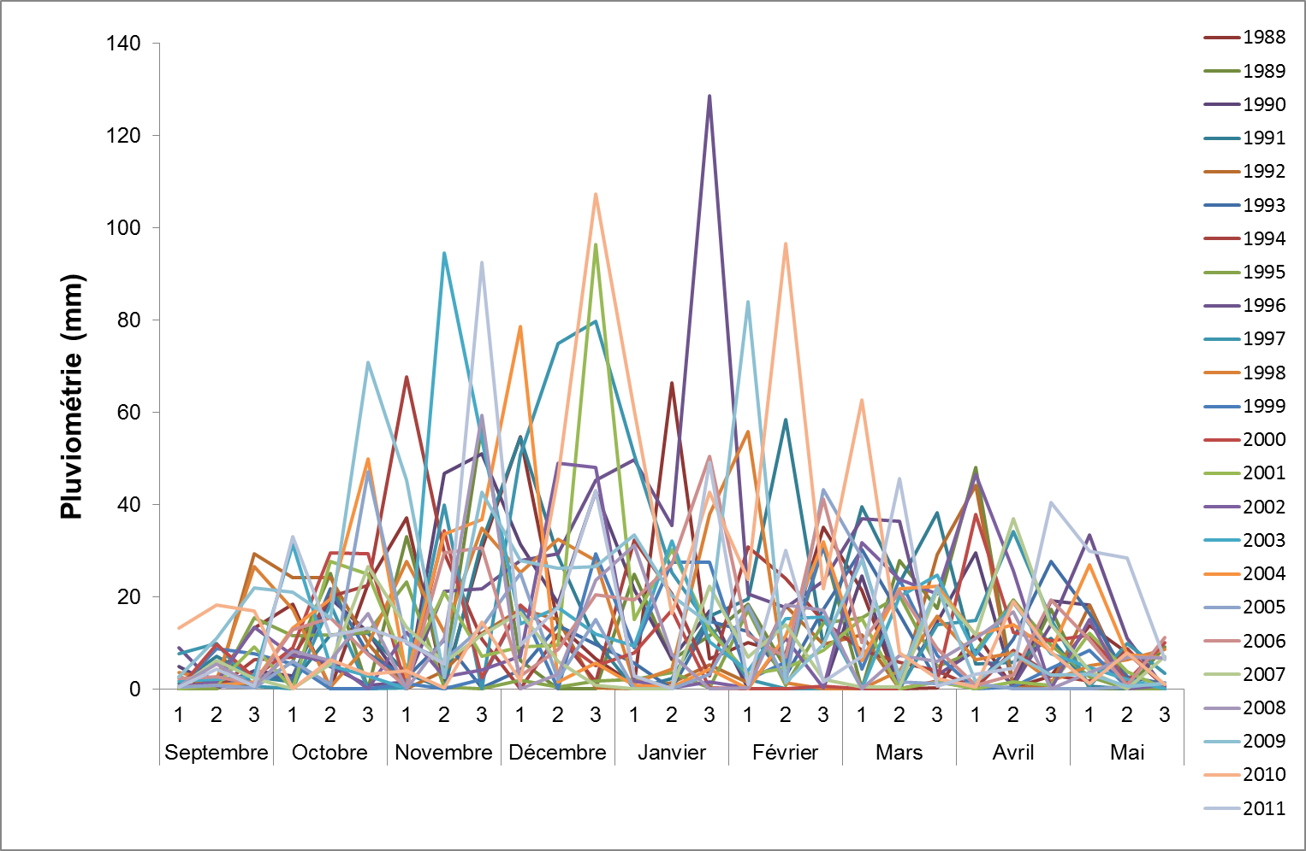
Rainfall variability in Morocco

Slide 4
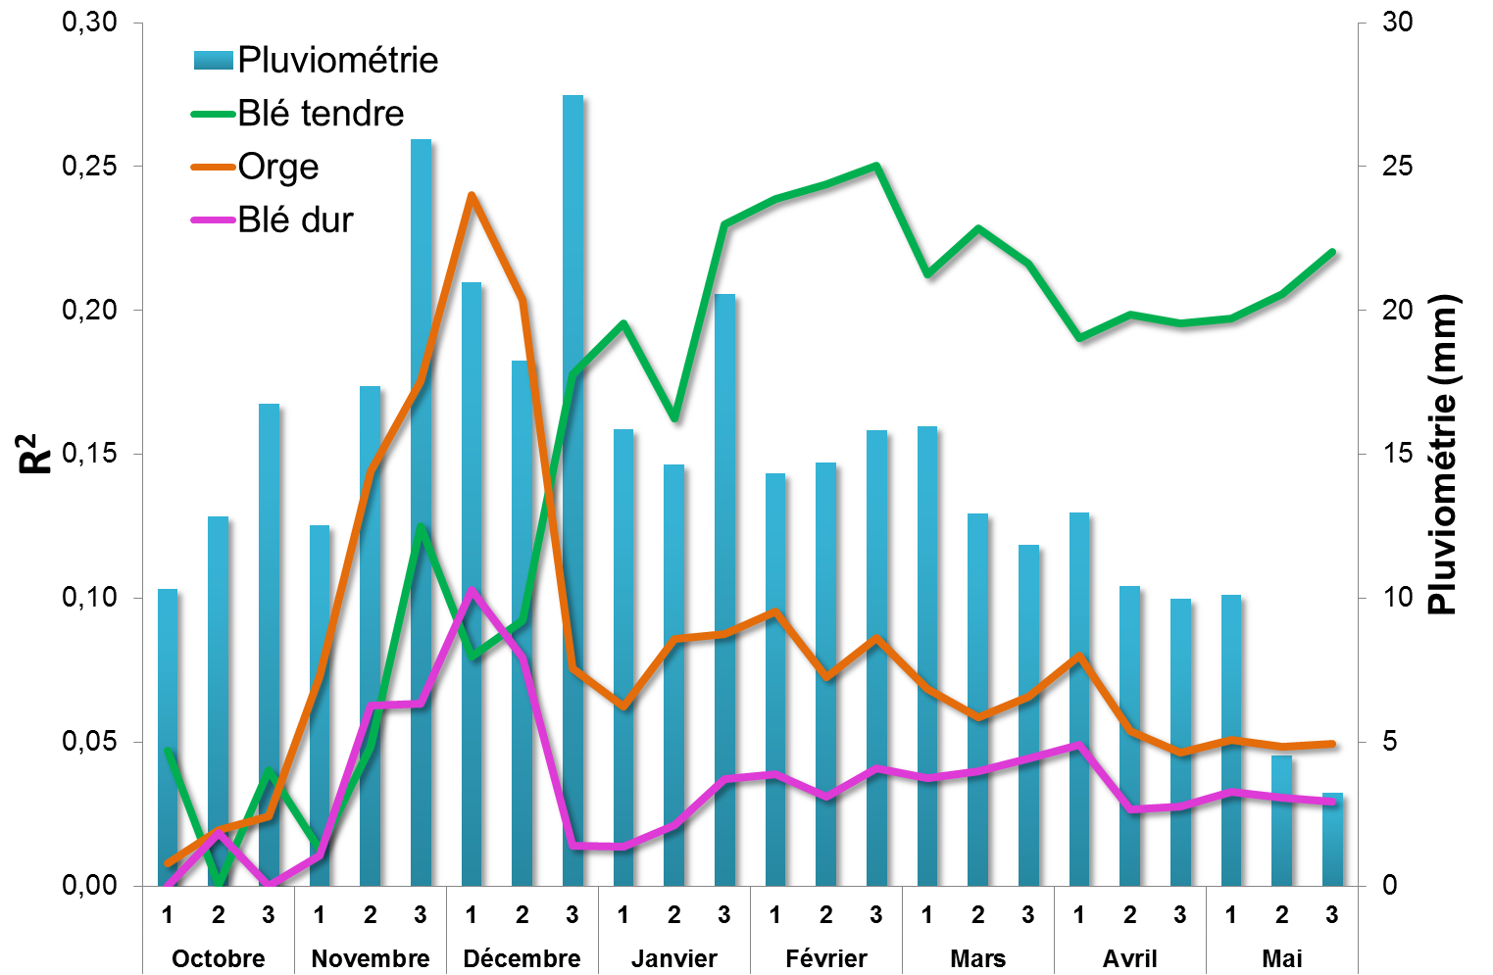
Relationship between rainfall and cereal area

Slide 5
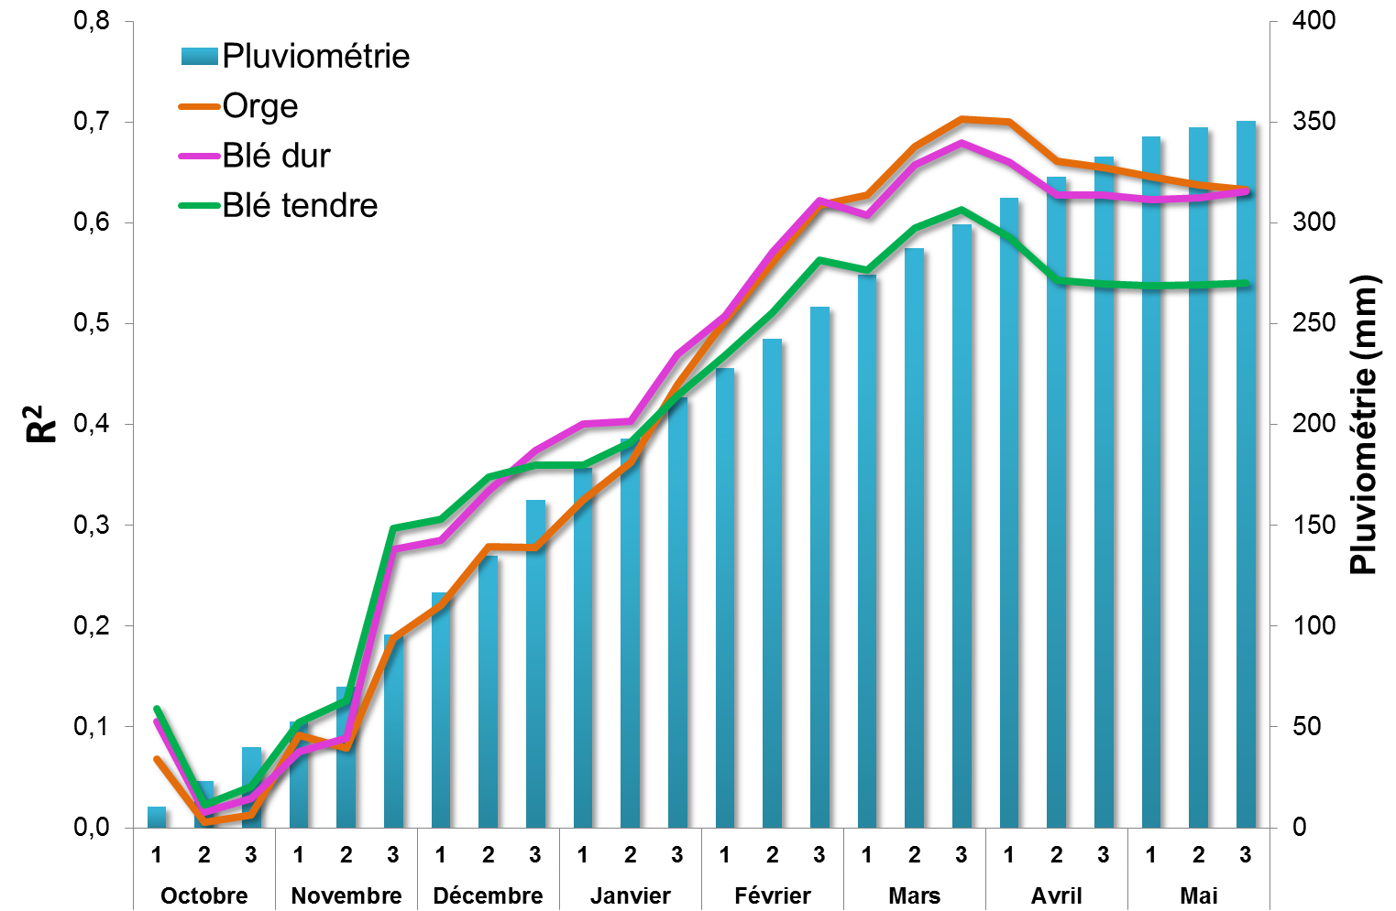
Relationship between rainfall and cereal yield

Slide 6
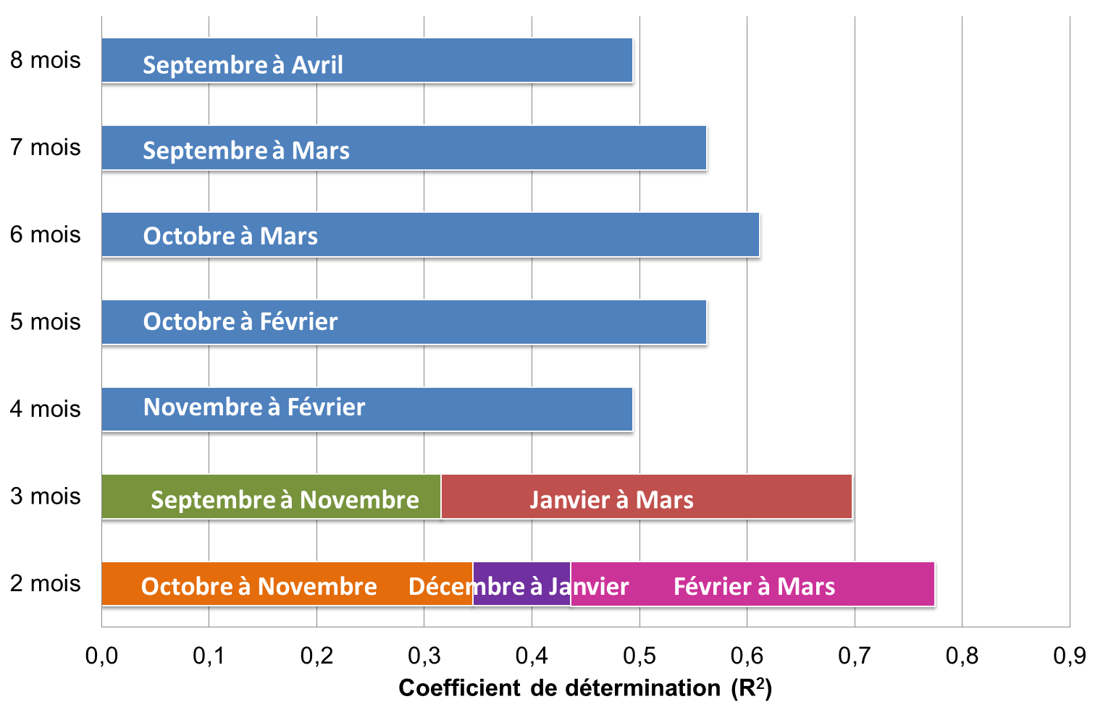
Statistical cereal yield models

Slide 7
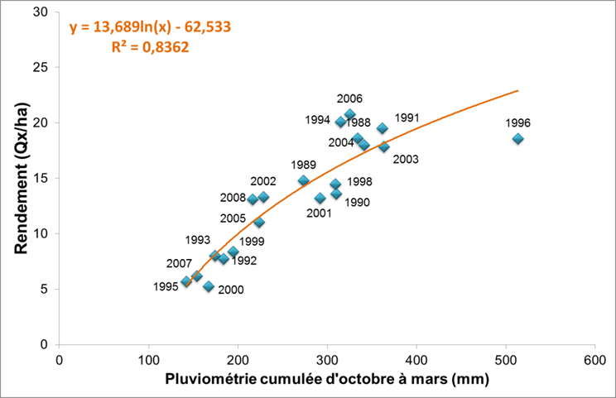
Statistical cereal yield models (rainfall)

Slide 8
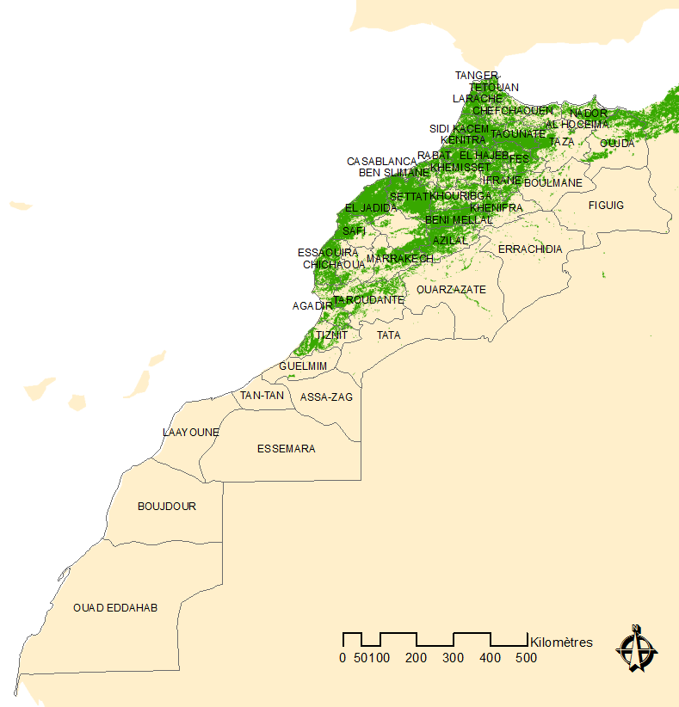

Slide 9
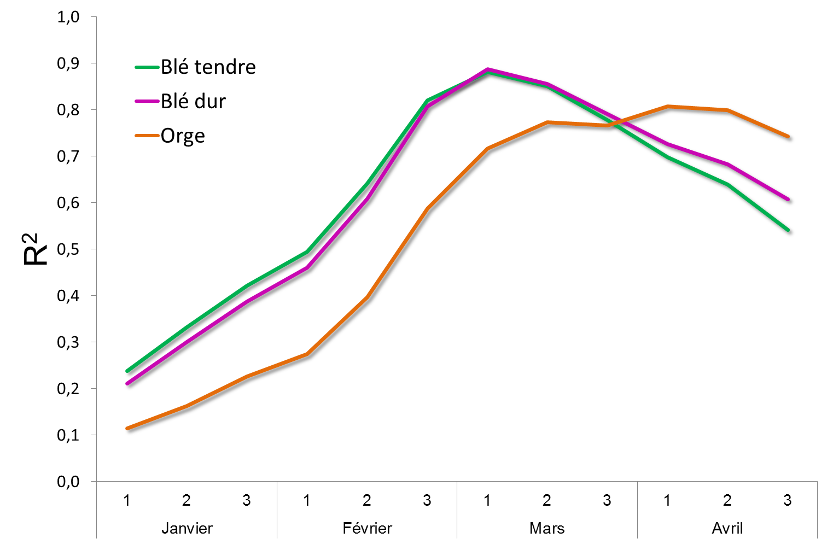
Relationship between NDVI and cereal yield

Slide 10
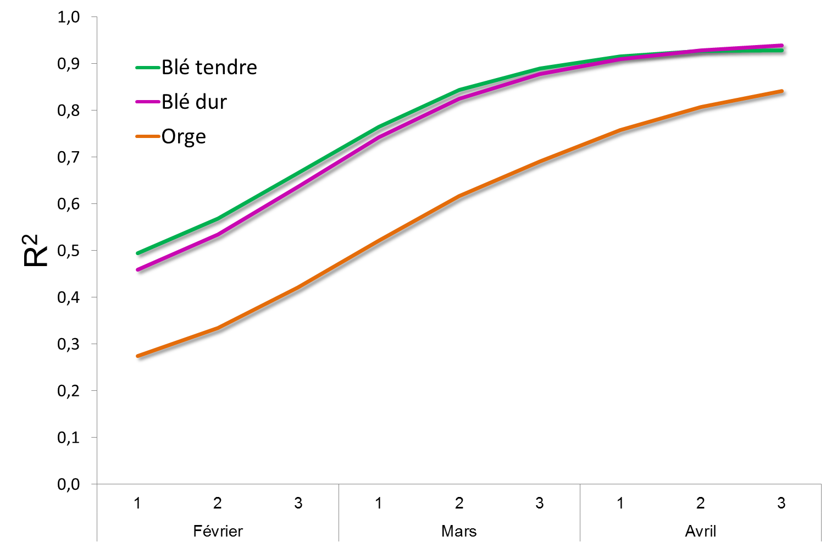
Statistical cereal yield models (NDVI)

Slide 11
Relationship between NDVI and Soft wheat yield (province level)

Slide 12
شكرا
謝謝您
Thank you

